Slide 1
DATA BASES AND DATABASE USERS

Slide 2
The functions of DBMS:
Defining a database involves specifying the data types, structures and constraints for the data to be stored in the database
Constructing the database is the process of storing the data itself on some storage medium that is controlled by the DBMS
Manipulating the database includes functions like querying the database to retrieve specific data, updating the database so as to reflect changes and generating reports from the data

Slide 3
The functions of DBMS:
Sharing the database allows multiple users and programs to access the database concurrently
DBMS protects the database. Protection includes both system protection against hardware or software malfunction and security malfunction against unauthorized access
A large database may have a life cycle for many years. Hence the DBMS must be able to maintain the database system by allowing the system to evolve as requirements change over time.

Slide 4
DBMS Users:
DBA - Data Base Administrator: DBA stands for Data Base Administrator. Database admin is responsible for managing the entire DBMS system. The DBA is responsible for authorizing access to the database, coordinating and monitoring its use and acquiring the software and hardware resources as needed. DBA is also responsible for system security.
DB Designers: These are people who are responsible for identifying data to be stored in the database and for choosing appropriate structures to represent and store data

Slide 5
DBMS Users:
End Users: The end users are the people who interact with the database management system. End users are people whose jobs require access to the database for querying, updating and generating reports. These people make use of the existing database.
Software Engineers: This class of users can be classified as follows
System analyst: People who determine the requirements of the end users
Application programmers: These people implement the above specification as programs, then test and debug and maintain the software for which the database was designed

Slide 6
Characteristics of Database Approach:
The characteristics of database approach vs. file processing are as follows:
1. Self-describing nature of database system
2. Insulation between data and programs and data abstraction
3. Support of multiple views of data
4. Sharing of data and multi-user transaction processing

Slide 7
Self-describing nature of database system:
A fundamental characteristic of database approach is that the database system contains not only the database but also a complete definition or description of the database structure and constraints.
The definition is stored in a DBMS catalog. The catalog contains information such as structure of each file, the type and storage format for each data item and various constraints on data.
The information stored in the catalog is called the meta-data and it describes the structure of primary database. This is used only by the DBMS users and DBMS software who need information about the database structure

Slide 8
Insulation between data and programs and data abstraction:
The structure of data files is stored in DBMS catalog separately from access programs . This property is called program-data independence.
The structure of the data file can be modified to reflect any changes in the data description.
Program-operation independence is a term where users define operations on data as a part of database operation. An operation is specified in 2 parts- the interface of an operation includes the name of the operation and data types of the parameters.
The characteristic that allows both program-data independence and program-operation independence is called data abstraction. In database approach, the detailed structure and organization of the file are stored in a catalog.

Slide 9
Support of multiple views of data:
A database typically has many users, each of whom may require a different view of the database. A view may be a subset of the database or may contain virtual data that is derived from database files.

Slide 10
Sharing of data and multi-user transaction processing
A multi user DBMS must allow multiple users to access the database at the same time . A transaction is an executing program or a process that includes one or more database accesses, such as reading or updating a database record. The two most important properties of transactions are:
1. Isolation: A transaction appears to execute in isolation from other transaction even though hundreds of transactions execute concurrently.
2. Atomicity: This ensures that either all the database operations in a transaction are executed or none are

Slide 11
Advantages of DBMS:
The advantages of DBMS approach are as follows :
1. Controlled Redundancy:
2. Restricting unauthorized access:
3. Providing Storage structures for efficient query processing:
4. Providing Backup and recovery:
5. Providing multiple user interfaces:
6. Represent complex relationships among data:
7. Enforcing integrity constraints:
8. Permitting inferencing and actions using rules:

Slide 12
1. Controlled Redundancy:
In traditional file processing each user group maintain their own files and handle data processing application. This leads to a stage where the same data is stored in multiple files. The redundancy of storing data in more than one file creates a lot of problems
• Entering a new record should be done on multiple files leads to duplication of effort
• Storage space is wasted since the same details appear in all the files
• Data inconsistency- if a record is modified in one file this updation does not reflect in other files In order to overcome these limitations, the database approach integrates all the views of the different user group during database design. All the required details are stored in the database in one place. This ensures consistency and saves storage space. But, in practice, only some data items may repeat themselves at the required places. This phenomenon is called controlled redundancy.

Slide 13
2. Restricting unauthorized access:
When multiple users share a large database, it is likely that all users will not want all the information in the database. Moreover, all the users will not be authorized to use all the data. Some users may be only allowed to retrieve while others may be allowed to retrieve a well as to update data. In order to provide authorization, users are given user names and passwords. A DBMS provides security and authorization subsystem, which the DBA uses to create accounts and passwords to different users.

Slide 14
3. Providing Storage structures for efficient query processing:
Database systems must provide capabilities for efficiently executing a query. DBMS must provide specialized data structures to speed up disk access. The query processing and optimization module of the DBMS is responsible for choosing efficient query execution plan for each query based on the existing storage structures

Slide 15
4. Providing Backup and recovery: DBMS must provide facilities for recovering from hardware or software failures. The backup and recovery systems are responsible for recovery of data in such situations
5. Providing multiple user interfaces: DBMS has a wide variety of users. Hence, it should provide multiple user interfaces for each class of user. For example: Query language for casual users, programming language interface for application programmers.

Slide 16
6. Represent complex relationships among data: A database may contain a variety of data that are interrelated. DBMS must provide a capability to represent complex relationship among data as well as o retrieve and update related data only.
7. Enforcing integrity constraints: DBMS should provide capability for defining and enforcing integrity constraints. For example, specifying data types for each data item is done to ensure that erroneous data is not entered into the data base

Slide 17
8. Permitting inferencing and actions using rules: Some database provides capabilities for defining deduction rules for inferencing new information from the stored database facts. Such systems are called deductive database systems. Some database provides active rules that can automatically initiate actions when certain events and conditions occur.

Slide 18
Chapter - 2
DATABASE SYSTEMS - CONCEPTS AND ARCHITECTURE

Slide 19
Data Models:
A data model is a collection of concepts that can be used to describe the structure of database and provides necessary means to achieve this abstraction.

Slide 20
Categories of data models:
1. High-Level or conceptual data models- provide concepts that are close to the way how many users perceive data
2. Low-Level or physical data models – provide concepts that describe details of how the data is stored in computers.

Slide 21
Representational data models can be categorized as: -
a. Hierarchical model
b. Network model
c. Relational model

Slide 22
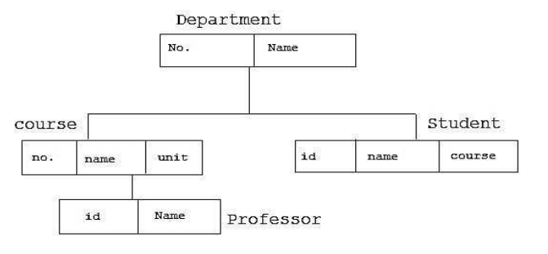
Hierarchical Data Model:
Here different records are interrelated through a hierarchical or a tree like structure. A parent record can have several children but a child can have only one parent. At the top of hierarchy there is only one entity which is called Root.

Slide 23
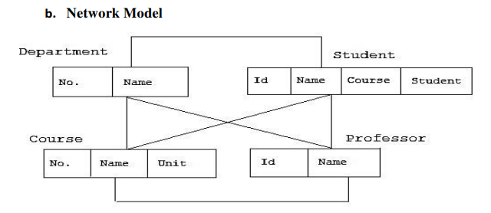
Network Data Model:
Here, a parent record can have several children and a child record can also have many parent records.

Slide 24
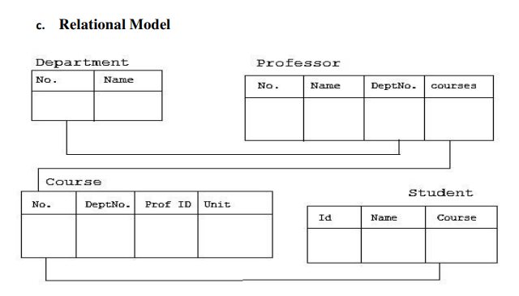
Relational Data Model:
In this model, there are no physical links between records. All the data is maintained in the form of tables, comprising of rows and columns. Data in two tables is related through common columns. Querying is much easier in this model. It is very much programmer friendly and is the most widely used model.

Slide 25
Schemas and Instances
The overall design of a database is called schema which is specified during database design and is not expected to change.
A diagram used to display schema is called a schema diagram.
Each object in the schema is called a schema construct.
A database schema is the skeleton structure of the database. It represents the logical view of the entire database. A schema contains schema objects like table, foreign key, primary key, views, columns, data types, stored procedure, etc.
Meta data: The description of the schema constructs and constraints is called meta data. The meta data is stored in the DBMS catalog so that DBMS software can refer to it whenever necessary.

Slide 26
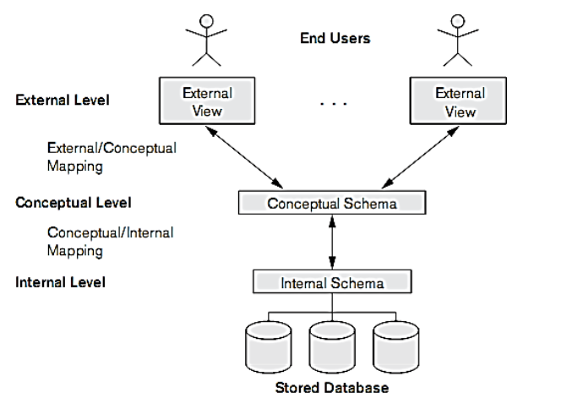
Three Schema Architecture:

Slide 27
Three Schema Architecture:
The internal level has an internal schema, which describes the physical storage structure of the database. The internal schema uses physical data model and describes the complete details of data storage and access paths for the database.
The conceptual level has a conceptual schema which describes the structure of the whole database for a community of users. It hides details of physical storage and concentrates on describing entities, data types, relationships, operations and constraints. The representational model is used to describe the conceptual schema.
The external or view level includes a number of external schemas or user views. Each external schema describes a part of the database that a particular user group is interested and hides the rest of the database from that user group. The process of transforming requests and results between levels is called mappings.

Slide 28
Data Independence:
Data independence can be defined as the capacity to change the schema at one level of the database system without having to change the schema at the next higher level.
There are two types of data independence logical data independence and physical data independence.

Slide 29
Data Independence:
Logical Data Independence: It is the capacity to change the conceptual schema without having to change external schemas or application programs. We may need to change the constraints or reduce the database. After the conceptual schema undergoes logical reorganization, application programs that reference the external schema constructs should work as before.
Physical Data Independence: It is the capacity to change the internal schema without having to change conceptual schemas. Changes to the internal schema may be needed because physical files had to be reorganized. The three-schema architecture makes it easier to achieve true data independence i.e. both physical and logical data independence.

Slide 30
Database Languages:
One language called the DDL (Data Definition Language) is used by the DBA and designers to define both the schema.
The DBMS will have a DDL compiler whose function is to process the DDL statements in order to identify the descriptions of the schema constructs and to store the schema description in the DBMS catalog. The DDL is used to specify the conceptual schema(Datatypes,constriants) only.

Slide 31
Database Languages:
Storage Definition Language is used to describe the internal schema.(How the data is stored)
Manipulations in the database include retrieval, insertion, deletions and modification on data. DBMS provides a language called DML (Data Manipulation Language) to perform manipulations on the data in the database. There are two main types of DML. They are

Slide 32
Database Languages:
High level or non-procedural DML:
It can be used on its own to specify complex database operations in a concise manner. E.g., SQL. High level DML such as SQL can specify and retrieve many records in a single DML statement

Slide 33
Database Languages:
Low level or procedural DML:
They are embedded in a general-purpose programming language. This type of DML retrieves individual records or objects from the database and processes them separately. They are also called record-at-time DML.

Slide 34
DBMS Interfaces:
a. Menu based interfaces for web clients or browsers: These help the users with a list of options called menus that lead the user through formulation of requests. The user need not remember any command or syntax of the query language. The query is composed step by step by picking options from the menu.
b. Form based Interfaces: It displays a form to each user. Users can fill data in the form to insert new data. The user can also fill specific entries in which case the DBMS retrieves data from the database
c. Graphical user interfaces: A GUI displays a schema in a diagrammatic form to the user. The user specifies a query by manipulating the diagram. A pointing device such as mouse is used.

Slide 35
DBMS Interfaces:
d. Natural Language Interfaces: These interfaces accept request written in English and attempts to understand them. It has its own schema and dictionary of important words.
e. Interface for parametric users: Parametric users such as bank tellers perform small set of operations on the database repeatedly. A small set of abbreviated commands are included to minimize the number of keystrokes for each request.
f. Interface for DBA: Privileged commands can be used only by the DBA. These include commands for creating user accounts, granting account authorization and reorganizing storage structure of data.

Slide 36
Classification of DBMS:
There are several criteria on which DBMS can be classified. They are:
1. Based on data models
2. Based on number of users
3. Based on number of sites
4. Based on types of application.

Slide 37
Data Models:
Based on data models, DBMS can be classified as
a. Relational Data Model- data is organized as tables
b. Hierarchical Data model- data is stored and related through tree like structures.

Slide 38
Number of users:
Depending on the number of users supported by the system, DBMS can be categorized into
a. Single user systems- that support only one user at a time
b. Multi-user system – that support multiple users concurrently

Slide 39
Number of sites:
Based on the number of sites over which the database is distributed , DBMS can be classified as
a. Centralized DBMS- Here the data is stored at a single computer site. It supports multiple users but the DBMS and database reside at a single computer site.
b. Distributed DBMS- The database and DBMS are distributed over many sites connected through network.
This can again be divided as
i. Homogeneous DDBMS: They use same DBMS software at multiple sites
ii. Heterogeneous DDBMS: They use different DBMS software at different sites

Slide 40
Types of application:
Based on the types of application DBMS can be classified as follows:
a. General Purpose DBMS: DBMS that can be used for all types of application
b. Special Purpose DBMS: DBMS used for a specific application for which they are designed. E.g., airline reservation – it cannot be used for other applications.

